Slide 1

Convolutional Neural Networks (CNN) and Long Short-Term Memory (LSTM) based Application Programming Interface (API) to predict Emotion over web
DOMAIN: CLOUD COMPUTING ; DEEP LEARNING
BATCH 9
GUIDE:
Ms.V.Sathya
PRESENTED BY:
M.Nisha [ 211417104167 ]
M.Priyadharshini [ 211417104203 ]
Muppala Navya Sree [ 211417104155 ]

Slide 2
INTRODUCTION
The development and usage of computer systems, software and networks are growing tremendously. These systems have an important role in our everyday life and they make human life much easier.
. Facial emotion recognition system assumes a lot of importance in this era since it can capture the human behavior, feelings, intentions etc. The conventional methods have limited speed and have less accuracy while facial emotion recognition systems using deep learning has proved to be the better one.
In this project, we use an Amazon EC2 Linux instance to create an Application Programming Interface (API) that predicts facial expression.
. Training and performance assessment are carried out using algorithms and models such as Long Short-Term Memory (LSTM) and Convolutional Neural Networks (CNN).
A Fully Convolutional Neural Network based classifier is used to predict the facial emotions of the person in the image. An FCN (Fully Convolutional Network) is a network composed of only convolutional layers, batch norms and non-linearities, i.e., it has no fully Connected (or Dense) layers.
Backpropagation of errors is used to assess the API's effectiveness after multiple defeats and experiments.

Slide 3
LITERATURE SURVEY
Year | Author | Title of paper | Methodology | Inference
2019 | TZUU-HSENG S. LI , PING-HUAN KUO , TING-NAN TSAI , AND PO-CHIEN LUAN | CNN and LSTM Based Facial Expression Analysis Model for a Humanoid Robot | Convolutional neural network, long short-term memory, transfer learning, facial expression analysis. | The proposed model combines CNN and LSTM and exploits the advantages of both CNN and RNN. Leave-one-out cross-validation indicates that the model performance is improved significantly
2019 | Berat A. Erol, , Abhijit Majumdar,Patrick Benavidez ,Paul Rad, Kim-Kwang Raymond Choo and Mo Jamshidi, | Toward Artificial Emotional Intelligence for Cooperative Social Human– Machine Interaction | Assistive robotics, human–machine interactions, humanoid robot, Internet of robotic things, smart home, supervisory control. | The paper presents an interactive heterogeneous robotic system with several components working together for closing the loop by detecting human emotions from facial images. The ultimate goal was designing a system of systems that fulfills user’s requests by actively interacting with them, while other system components were gathering and sharing the data.

Slide 4
Year | Author | Title of paper | Methodology | Inference
2019 | D Y Liliana | Emotion recognition from facial expression using deep convolutional neural network | Facial expression recognition, action unit, deep learning, convolutional neural network, dropout | proposed Convolutional Neural Network architecture for facial expression recognition. There are 8 classes of facial expression that are tried to recognize.Using the CK+ database we trained using different training data size and the result is the mean square error declines as the number of training data increases and it is concluded that the mean square error declines as the training data grows and the performance of the system reaches 92.81% of the accuracy rate.
2018 | Md. Forhad Ali,Nakib Aman Turzo, Mehenag Khatun | Facial Emotion Detection Using Neural Network | Feature Extraction, Neural Network, Emotion Recognition, Emotion Detection, Facial Recognition. | With the CNN, it was possible to identify emotions, type of emotion in the real image. To delineate the result and procedures more visually and this has also introduced decision tree techniques which helps to decide which emotions percentage is high and which emotions percentage is low.

Slide 5
Year | Author | Title of paper | Methodology | Inference
2016 | Zixing Zhang, Fabien Ringeval, Fabien Ringeval, Eduardo Coutinho, Erik Marchi and Björn Schüller | Enhanced semi-supervised learning for multimodal emotion recognition | Semi-Supervised Learning (SSL) technique | Delivers a strong performance in the classification of high/low emotional arousal (UAR = 76.5%), and significantly outperforms traditional SSL methods by at least 5.0% (absolute gain).
2016 | Y. Fan, X. Lu, D. Li, and Y. Liu.(2016) | Video-based emotion recognition using CNN-RNN and C3D hybrid networks | CNN-RNN and C3D hybrid networks | Achieved accuracy 59.02% (without using any additional Emotion labeled video clips in training set) which is the best till now.

Slide 6
PROBLEM STATEMENT
Human facial expressions can be easily classified into 7 basic emotions: happy, sad, surprise, fear, anger, disgust, and neutral. Our facial emotions are expressed through activation of specific sets of facial muscles. These sometimes subtle, yet complex, signals in an expression often contain an abundant amount of information about our state of mind.
Humans are well-trained in reading the emotions of others, in fact, at just 14 months old, babies can already tell the difference between happy and sad. But can computers do a better job than us in accessing emotional states?
To answer the question, We designed a deep learning neural network that gives machines the ability to make inferences about our emotional states to make this process fast and quick and efficient and to get high accuracy we develop an dedicated API to detect facial emotion over cloud.

Slide 7

TECHNOLOGY STACK
Long Short-Term Memory (LSTM)
+
Convolutional Neural Networks (CNN)
Deep Learning ->
Amazon API Gateway
{
Computation
->
Flask + Amazon EC2

Slide 8
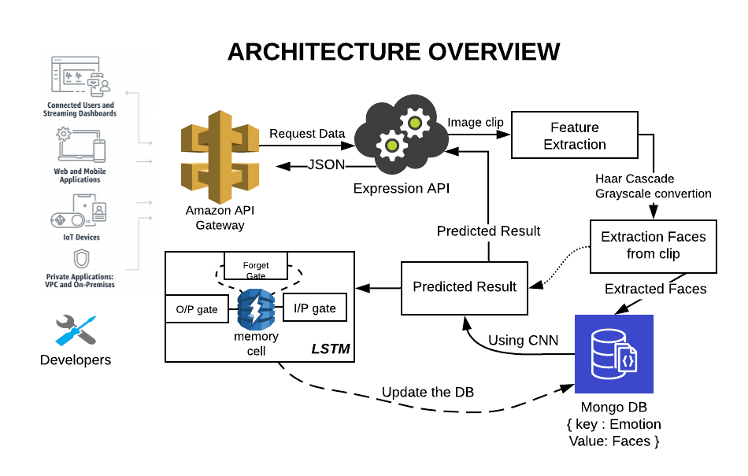

Slide 9
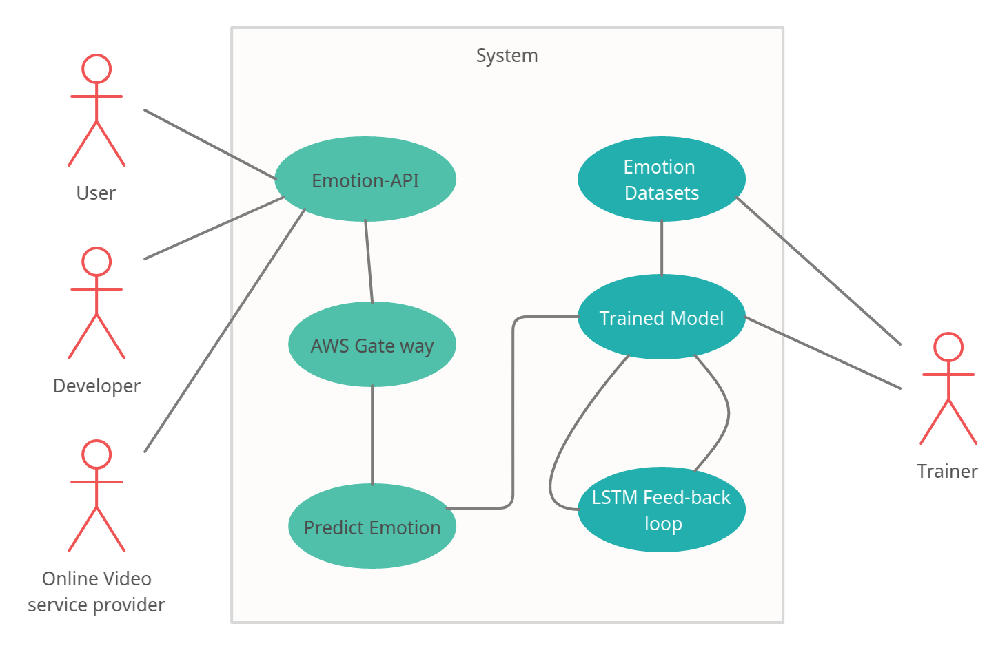
Use case Diagram

Slide 10
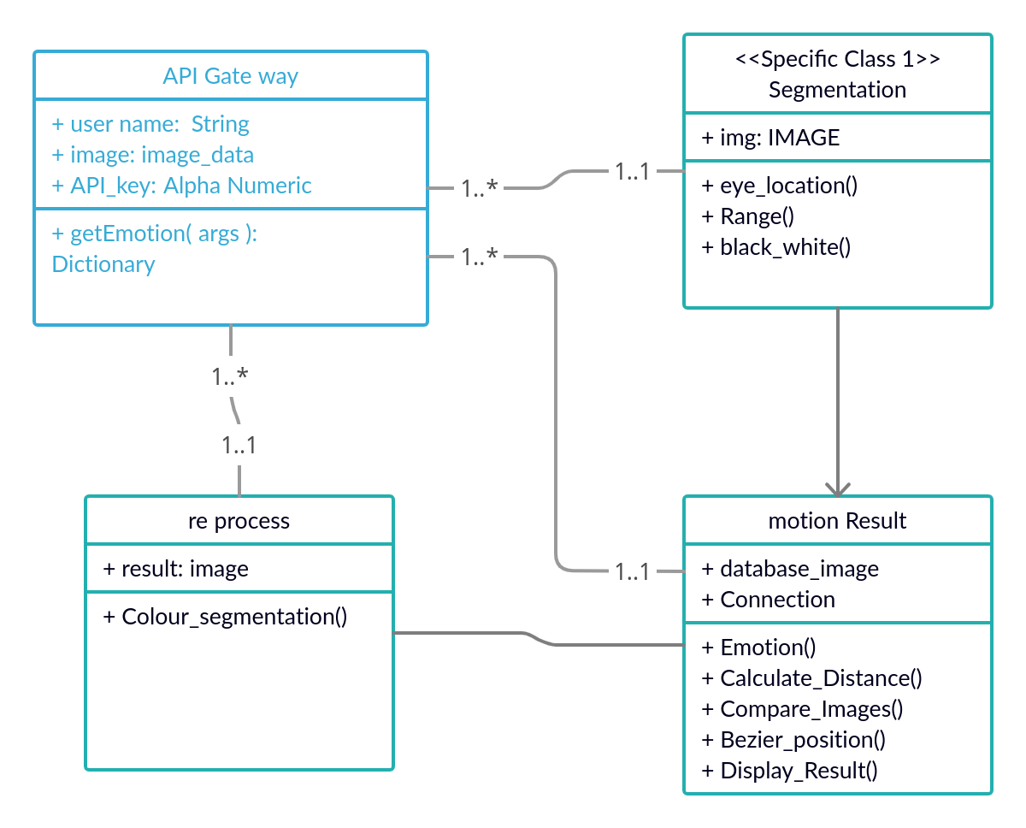
Class Diagram

Slide 11
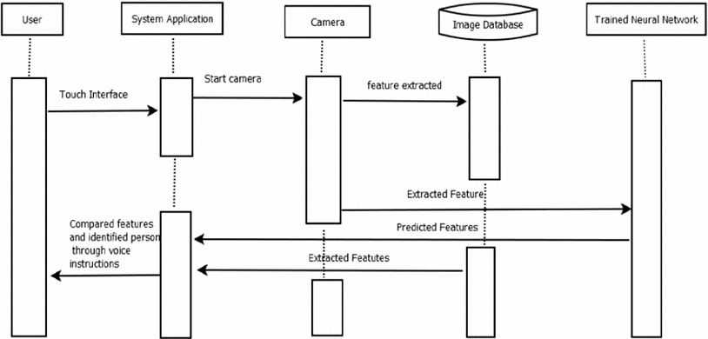
Sequence Diagram
API interface
Compared Features and identified Emotions

Slide 12
Modules / Functionality
Creating CNN LSTM Model
Collecting, preparing and processing image Data
Training the model using CNN
Using LSTM to build up state, update weights and Back Propagate errors
Performance Evaluation
Carried out with encouraging results of previous experiments.

Slide 13
Collecting, Preparing and Processing Data
Collecting images to prepare dataset
Image enhancement and restoration
Coloured image processing to Grayscale
Morphological Processing and image segmentation
Conversion to Dataset using Pandas and sklearn

Slide 14
Training the Model Using CNN
Create a Test and Train set from prepared dataset
Create a kernel of 7X7
Use Relu Activation
Train the layer with increasing epoches

Slide 15
Build single LSTM model
Transform input pixels into an internal matrix or vector representation.
build up internal state and update weights using BPTT (repeat above operation on multiple images)
Train by back propagating error from the LSTM across multiple input images to the CNN model.

Slide 16
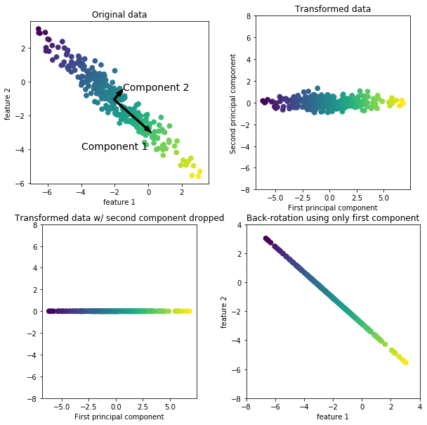
PERFORMANCE EVALUATION
The performance of the CNNs is used extract visual features by learning on a large number of static images.
The performance of the proposed system is verified through leave-one-out cross-validation and compared with that of other models. If the validation loss decreases then the accuracy will increase.
The system is applied to a humanoid robot to demonstrate its practicability for improving the HRI.
It involves a complex process and since the robot is made the cost of the project is also high and hence we came up with the only software solution which uses API based emotion detector with deep learning technique reducing complexity.
Effectiveness of the API is measured through several defeats and experiments by backpropagation of error's. In this experiment we found that using static images average 95% results are correctly matched with the images during training we are getting 95% accuracy on testing.

Slide 17
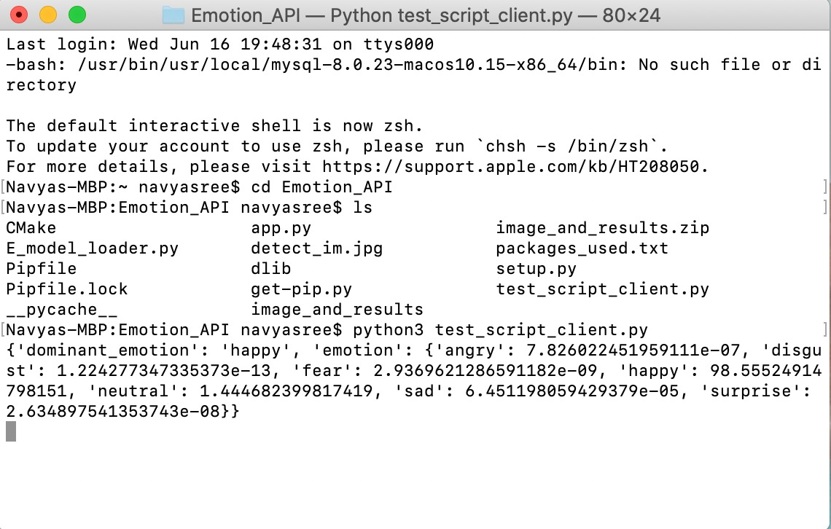
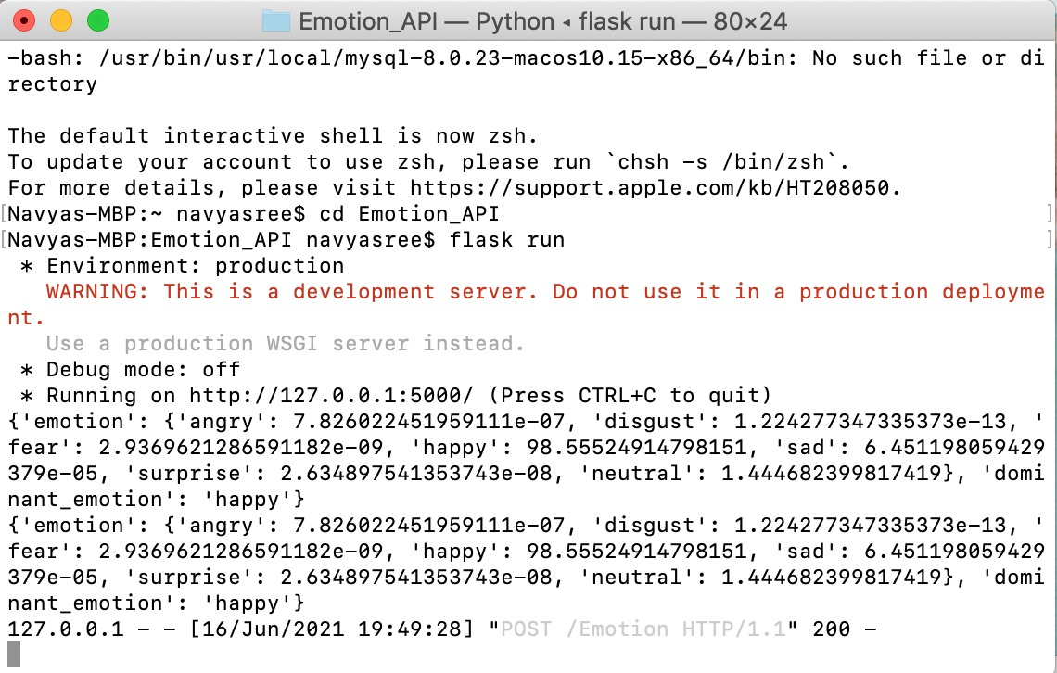
SCREENSHOTS

Slide 18
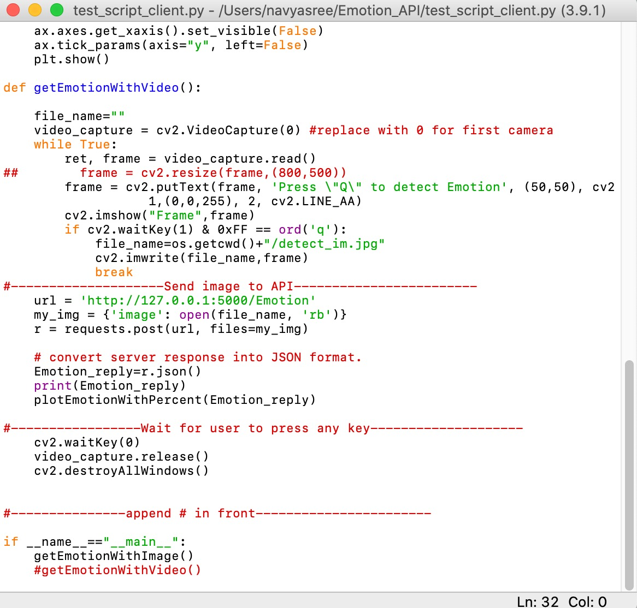
INPUT can be given in two ways :
Image
Video
By enabling the specified format , we can
feed input either image or video format .

Slide 19

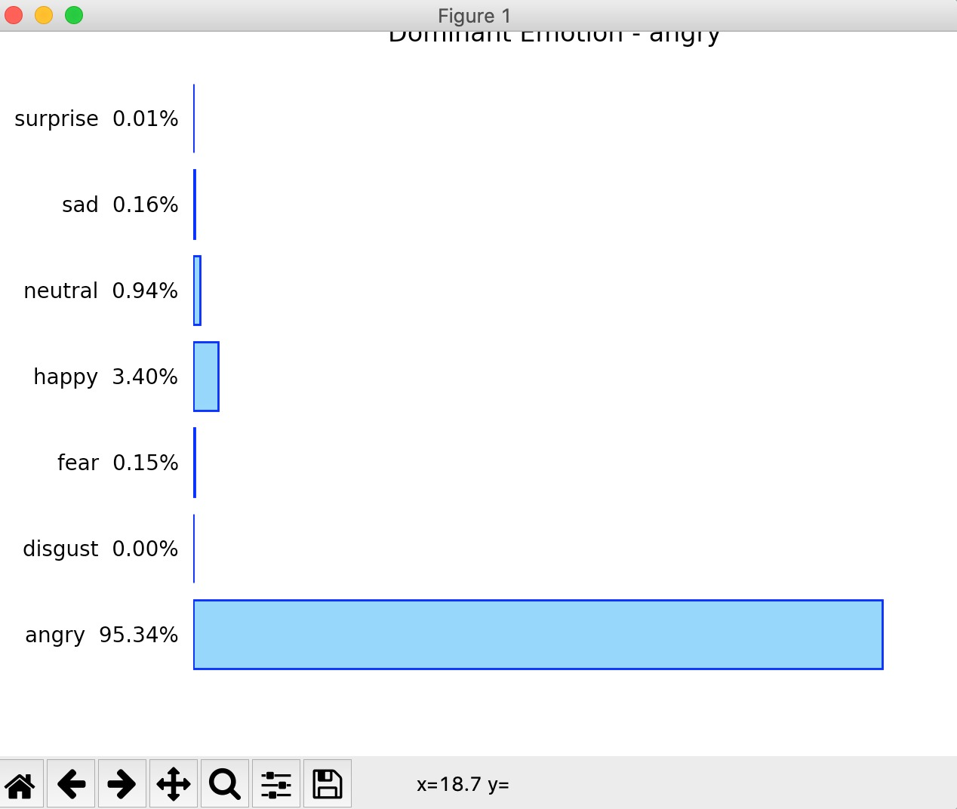

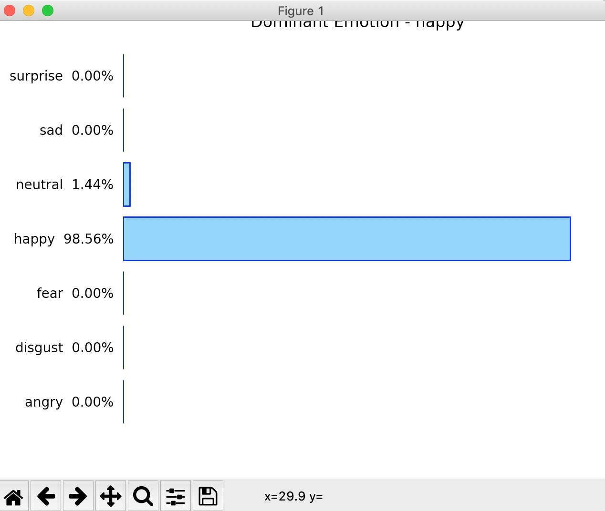
IMAGE

Slide 20

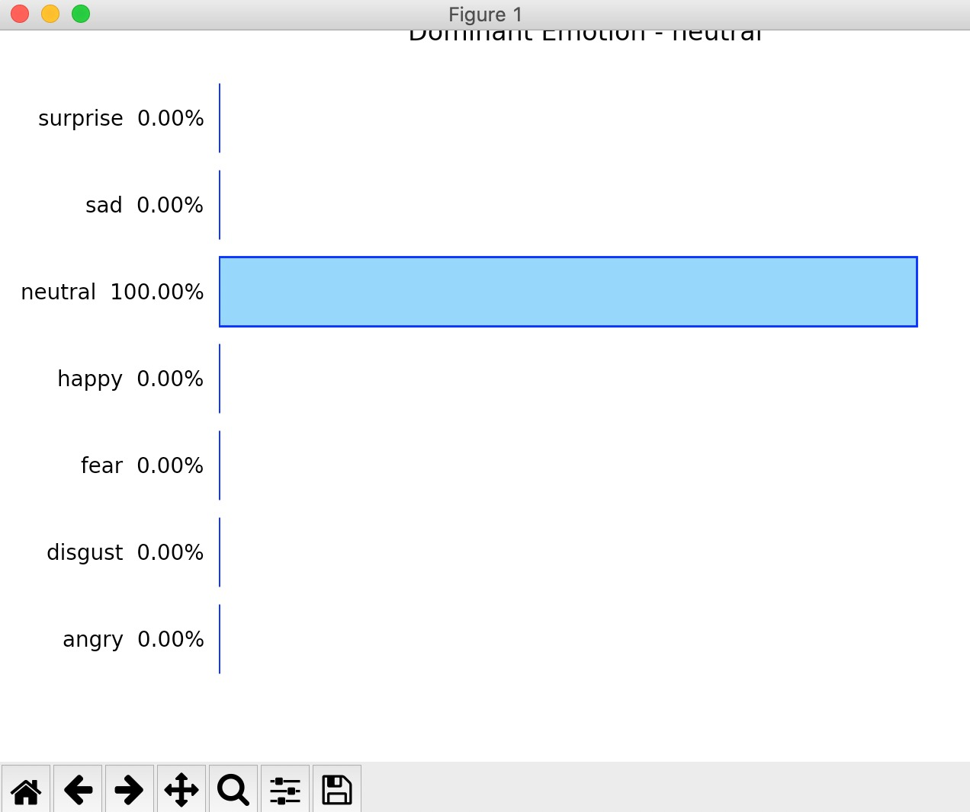
VIDEO

Slide 21
CONCLUSION
By Performing CNN on model we are able to get around ~84.2% of accuracy. To increase accuracy and capability of the project we have introduced LSTM (long short term memory) which constantly monitors the performance of the system in prediction and performs addition and removal of dataset from training the model.
This repeated process increases the efficiency and performance of the system with good results. This is similar to feed back loop which provides stability to the system

Slide 22
REFERENCE
1.TZUU-HSENG S. LI , PING-HUAN KUO , TING-NAN TSAI , AND PO-CHIEN LUAN,”CNN and LSTM Based Facial Expression Analysis Model for a Humanoid Robot”,2019,IEEE Access
2.Berat A. Erol, , Abhijit Majumdar,Patrick Benavidez ,Paul Rad, Kim-Kwang Raymond Choo and Mo Jamshidi,”Toward Artificial Emotional Intelligence for Cooperative Social Human– Machine Interaction”,2019,IEEE
3.D Y Liliana,”Emotion recognition from facial expression using deep convolutional neural network”,2019
4.Md. Forhad Ali,Nakib Aman Turzo,Mehenag Khatun,”Facial Emotion Detection Using Neural Network”,2018
5.Zixing Zhang, Fabien Ringeval, Fabien Ringeval, Eduardo Coutinho, Erik Marchi and Björn Schüller,”Enhanced semi-supervised learning for multimodal emotion recognition”,2016
6.Y. Fan, X. Lu, D. Li, and Y. Liu.(2016),”Video-based emotion recognition using CNN-RNN and C3D hybrid networks”,2016.
7. M. Ghayoumi, M. Thafar, and A. K. Bansal, ‘‘Towards formal multimodal analysis of emotions for affective computing,’’ in Proc. Int. Conf. Distrib. Multimedia Syst., 2016, pp. 48–54

Slide 23
[8] P. Ekman, W. V. Friesen, M. O’Sullivan, A. Chan, I. Diacoyanni-Tarlatzis, K. K. Heider, W. A. LeCompte, T. Pitcairn, P. E. Ricci-Bitti, K. Scherer, M. Tomita, and A. Tzavaras, ‘‘Universals and cultural differences in the judgments of facial expressions of emotion,’’ J. Personality Social Psychol., vol. 53, no. 4, pp. 712–717, 1987.
[9] F. T. Giuntini, L. P. Ruiz, L. De F. Kirchner, D. A. Passarelli, M. De J. D. Dos Reis, A. T. Campbell, and J. Ueyama, ‘‘How do I feel? Identifying emotional expressions on facebook reactions using clustering mechanism,’’ IEEE Access, vol. 7, pp. 53909–53921, 2019.
[10] M. Nicolaou, H. Gunes, and M. Pantic, ‘‘Continuous prediction of spontaneous affect from multiple cues and modalities in valence-arousal space,’’ IEEE Trans. Affective Comput., vol. 2, no. 2, pp. 92–105, Apr. 2011.
[11] P. C. Petrantonakis and L. J. Hadjileontiadis, ‘‘Emotion recognition from brain signals using hybrid adaptive filtering and higher order crossings analysis,’’ IEEE Trans. Affective Comput., vol. 1, no. 2, pp. 81–97, Jul. 2010.

